Slide 1

SEED Fund
Collaborative Solar Procurement for Public Agencies
Solar Project Installation and Technical Considerations
June 2019

Slide 2
Agenda
Introduction to SEED Fund Team
SEED Fund Project Overview and Status Update
Solar Value Proposition
  Long-Life Asset
  Offset of Electrical Costs
  Financial Incentives and Programs
  Alternative Energy Valuations
Financing Options & Evaluation Process
  Direct Purchase
  Power Purchase Agreement
  Equipment Lease
Next Steps

Slide 3



About Strategic Energy Innovations (SEI)
Strategic Energy Innovations inspires & empowers to advance solutions for a healthy, thriving planet.
  Committed to empowering under-served markets
  Schools, colleges, and universities
  Local governments
  Small and rural communities
  Affordable housing providers and residents
  Small businesses
  …to embrace a climate-friendly future through green building, clean energy, resource efficiency and support of a local and qualified green workforce.

Slide 4




About Optony Inc.
Optony develops and deploys clean energy best practices across the entire project lifecycle for government agencies, schools, banks and commercial organizations. Optony has been involved in over 3GW of project activity globally from strategy to project commissioning.
Award Winning
Pubic Sector Project
Award Winning
Pubic Sector Project
Multiple Grant-Winner for Solar Market Transformation
Best of Silicon Valley Recognition for Energy Services
“Optony's consulting service is a must-have for any organization considering an investment in solar. Based on Optony’s comprehensive analysis and recommendations, we now have a low-risk, high-return solar strategy.”

Slide 5

About Sierra Business Council (SBC)
Sierra Business Council is an organization focusing on the environment, communities, and economies of the Sierra region. We’re a certified non-profit in both California and Nevada and have a 20-year history in the region.
  Implements projects in several areas of expertise
  Community planning
  Natural area conservation and open space planning
  Rural economic development
  Collaborative process facilitation
  Sustainable business practices
  … to increase community vitality, economic prosperity, environmental quality, and social fairness in the Sierra Nevada.

Slide 6
The SEED Fund
Collaborative group procurement for solar PV to take advantage of economies of scale
Revolving fund addresses the barrier of upfront costs
  3-step opt-in program to empower private and public agencies to evaluate solar PV projects and participate in collaborative procurement
  Does not require upfront funds for project planning, site assessments, or procurement activities
Provides unbiased technical and financial analysis to help evaluate solar PV procurement options
If projects gain approval, vendors reimburse a small percentage of project cost to the SEED fund

Slide 7
SEED Fund Structure
SPONSOR
(CSI RD&D Grant; Previous Rounds of SEED Fund)
Multiple Rounds
Regional Collaborative Purchasing Initiative
Memorandum of Understanding
SEED FUND, LLC
PARTICIPANTS
VENDORS
OPTONY
SEI
Technical Assistance
Solar Contract
Reimbursement for Next Round of SEED Fund Procurement

Slide 8
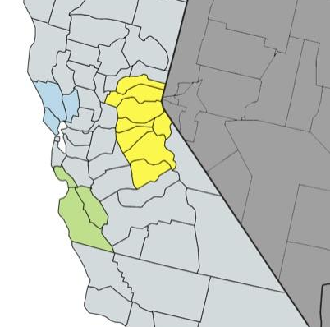
Past Regional Rounds
8 Agencies in RFP
Led by County of Santa Cruz
34 total sites
12 MW considered; ~3 MW constructed; ~3 MW in negotiations
SEED Monterey Bay
SEED North Bay
13 Agencies in RFP
Led by City of San Rafael
32 total sites
4.3 MW constructed; 0.3 MW in design

Slide 9
Participation Timeline
Fall 2018-Summer 2019
Summer-Winter 2019
Spring 2020
Recruit Participants
Sign MOU
Assess Sites
Attend Workshops
Issue RFP & Review Responses
Sign Contracts
Build Projects
Decision Point 1
Decision Point 2
Decision Point 3

Slide 10
Potential Participants and Solar Development
Participants | Status | Recommended Sites | Solar Potential (kW)
City of South Lake Tahoe | Lead Agency | 5 | 557
City of Nevada City | MOU | 1 | 2,852
Tahoe Truckee Sanitation Agency | MOU | 1 | 5,562
Truckee Tahoe Airport District | MOU | 2 | 9,389
Nevada City School District | MOU | 4 | 497
Grass Valley School District | MOU | 4 | 500
Tahoe Donner Association | MOU | 5 | 1,100
South Tahoe Public Utility District | MOU? | 2 | 1,135
Town of Truckee | MOU? | 7 | 2,679
Lake Tahoe Unified School District | MOU? | 4 | 2,322
Bear Valley Business Association | MOU? | 4 | 383
County of Nevada | MOU? | 12 | 3,202
Others in consideration | ?
Total |  | 51 | 30,178

Slide 11
Major Changes in the Solar Industry
Recent Changes
Major Impact On:
  Dramatic Drop in Panel Prices
  Consolidation in the Industry
  New Financial Players in the Market
  Maturing Industry
  US Markets are a Strong Focus
  Excess PV Capacity Coming Online
  Grid Parity Accelerating (without incentives)
  Utility and Federal Programs
  Better Project Economics
  Few, Stronger Players
  Lower Cost of Capital
  Safer Investments for Buyers
  PV Mfrs Must Lower Cost
  Must Seek Long-Term Stability
  Mass Adoption of Solar
  Rate Structures and Financing
11

Slide 12
What drives realization of solar value?
Robust technology with long-life components
  Low total cost of ownership and price stability for 25 years
  Properly designed and installed PV system
  Energy usage offset with expected facility load profile
Offset of Electricity Costs
  Net Energy Metering
  Solar-friendly Time-of-Use rate schedule; changes
Financial incentives and programs
  Production rebates and incentives
  Solar renewable energy credits / certificates
  Tax incentives (even useful for tax-exempt entities)
  Low-interest loans, bonds
Alternative energy valuations
  Feed-in Tariff, RES-BCT (AB 2466), Over-production credit (AB 920), Community Solar, Energy Storage
Notes:
Thanks
As we talk about solar, we need to talk about the expected life of the components, 25 years, with warranties included and low O&M costs
Design must be good to get efficient production: orientation, quality components, avoid shading
System should be sized appropriately to offset building usage, 80% is usually good
Key savings are electricity – Net Energy Metering allows selling at buy prices when the solar is produced, export is valuable when on TOU
Incentives and rebates – mostly gone, but still some value in trying and for 3rd party owned systems
Financing is getting cheaper as the asset class becomes better understood by financiers and investors
Some (limited) ability to sell electricity to the utility or CCA

Slide 13
Electricity Pricing Trends

Slide 14
Net Energy Metering (NEM)
Utility credits for export energy at same rate as they charge
  Best economics for solar
  Capped at 1 MW-AC per meter; varies
  Allows solar customers to take advantage of Time-of-Use (TOU) rates
A-6 PG&E rate schedule: “solar-friendly”
  Site/meter demand must remain below 500 kW
  No demand charges
  A-6 Peak summer rate: ~$0.60/kWh; Off-Peak summer rate: ~$0.15/kWh
  For every summer peak kWh exported to grid, you get credit for 4 off-peak kWh
  With this valuation, annual energy offset of ~65-85% can lead to attractive project economics (typically)
  Note: recent changes reduce eligible site demand to 75 kW (grandfathering); probable future demand charges

Slide 15
Rate Schedule Change: A-10 to A-6

Slide 16
Other Cost Offsets
Tax benefits
  Investment Tax Credit (ITC): 30% until end of 2016; 10% afterwards
  Accelerated Bonus Depreciation: 50% Depreciation in Year 1 (until end of 2013)
  Cannot be used directly by tax-exempt entities => PPAs/Leases
Solar Renewable Energy Credits (SREC)
  Highly valuable in some markets (Northeast), but minimal value in CA
Over-production credit
  AB 920 requires utility payment for energy generation higher than usage
  Only valued at market rate: ~$0.04/kWh

Slide 17
Financing Impacts Project Design, Process & Economics
Financing Structures
Changes Project:
  Direct Purchase
  Power Purchase Agreement
  Equipment Leasing
  Bond Financing
  Tax Exempt Lease
  Utility Financing
  Energy Service Contract
  Performance Risk
  Up-Front Costs
  Long-Term Returns
  Procurement Process
  System Design
  Project Benefits
  Operations & Maintenance
17

Slide 18
Direct Purchase
Ownership
  Customer owns, operates, and maintains the system
  Owner has full responsibility for performance
  Maintenance contracts and performance guarantees can be purchased
Capital Costs
  Full cost of system due at delivery (on construction schedule of payments)
  May be partially offset by rebates, grants & incentives (higher for non-profits/gov’t)
  Could be financed directly with existing processes (loan, lease, internal investment)
Financial Benefits
  High annual savings begin immediately and may be the highest over long-term
  Customer retains Solar Renewable Energy Credits (SREC)
  Customer receives federal, state, and local incentives and rebates
  However, non-taxable organizations cannot capture any tax benefits
  Low operating costs, effectively capping electricity costs for 25+ years
18

Slide 19
Solar Purchase Cash Flow Example*
Utility Savings
+ CSI Rebates
Utility Savings
- O&M
Utility Savings
- O&M
Inverter
Replacement
Initial
Investment
* Not an actual project site, but representative of the potential cash flows from a solar lease. All costs, benefits, terms, conditions, and cash flows may vary.
19

Slide 20
Power Purchase Agreement
Ownership
  PPA, LLC owns, operates, and maintains the system
  PPA receives all federal, state and local incentives, rebates (typically) and tax benefits
  System output is the responsibility of PPA, but Customer must buy ALL power produced
Capital Costs
  No up-front capital costs for buyer
  Legal services can be expensive
Financial Benefits
  Fixed price per kWh with known annual escalation (0% to 4%) over 20 years
  Savings are generally very low in the early years but increase over time
  PPA or Customer owns Solar Renewable Energy Credits (SREC), based on contract
  System sizing must be carefully evaluated and Performance Guarantees should be included
  Payback periods can be quite short because there is are no initial capital costs
  Customer can purchase the system at the end of the PPA term for FMV
20

Slide 21
Solar PPA Cash Flow Example*
Utility Savings
- PPA Costs
* Not an actual project site, but representative of the potential cash flows from a solar lease. All costs, benefits, terms, conditions, and cash flows may vary.
21

Slide 22
Equipment Lease
Ownership
  Leasing company (bank) owns the system
  Fixed monthly payments for 7-15 years (can be sculpted)
  Leasing company takes available federal tax benefits, or uses tax-exempt lease structure
  Customer has full responsibility for performance
  Maintenance contracts and performance guarantees can be included
Capital Costs
  Usually no up-front capital costs
  May be some transaction costs
Financial Benefits
  Lease term savings generally minimal, but then as high as purchase after lease term
  End of lease buy-out for FMV or 10-20% of initial value
  Customer generally retains Solar Renewable Energy Credits (SREC)
  Customer generally receives state and local incentives and rebates
Variation: Some PPAs can be structured like leases
22

Slide 23
Solar Equipment Lease Cash Flow Example*
Utility Savings
+ CSI Rebates
– Lease Payments
Utility Savings
– Lease Payments
- O&M
Inverter
Replacement
Utility Savings
- O&M
* Not an actual project site, but representative of the potential cash flows from a solar lease. All costs, benefits, terms, conditions, and cash flows may vary.
23

Slide 24
Indicative Cash Flows Across Financing Options

Slide 25
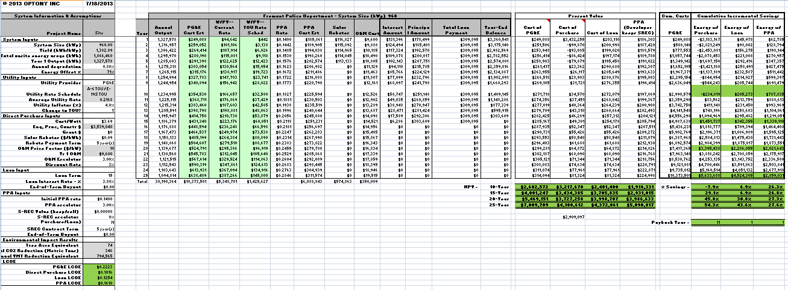
Financial Analysis
Review system sizing, pricing, assumptions, costs/benefits
Compare project cash-flows across various financing options
Used in developing Feasibility Assessment and to compare vendor proposals

Slide 26




Making the Case
Feasibility studies demonstrate technical & economic potential
Compare realistic financing options and assumptions
Look for available incentives and programs to reduce costs
Anticipate questions and provide concrete examples
Involve key decision-makers early in the process
Show long-term cost savings can more than pay for the effort
Connect projects to local and regional sustainability plans
Link to state requirements for GHG reductions
Involve community members to help support clean energy
Include economic impact and job creation benefits
26

Slide 27
Other Production Revenue Options
Feed-in Tariffs: Utility pays fixed rate per kWh for contract term
  FiT Feed-in Tariff
  Instead of fixed rate, price varies depending on supply
  Current pricing not available, but recently around $0.07-$0.09/kWh
  Developer would sell energy to utility; lease land from Agency (for $)
  Community Choice Aggregation (CCA)?
Renewable Energy Self-Generation – Bill Credit Transfer (RES-BCT) (AB 2466)
  Been in place since early 2010, but few applications (<10 in PG&E territory)
  Generating facility offsets facility use, then all energy exports are credited at TOU rate to Benefiting Accounts owned by same Agency
  Credits are only accrued at Generation Component of rate, not full retail which includes Transmission and Distribution (1/3 to 1/2 of full rate)
  Does not qualify for NEM
Net Surplus Compensation (AB 920)
  Utility must provide compensation for annual kWh exports (not excess $ credit)
  Compensation is at average spot market pricing (~$0.04/kWh)
  Not worth planning to over-build, but is an option if facility usage changes

Slide 28
Procurement Considerations
CA Government Code 4217
RFQ / RFP for competitive pricing
  Proposals rather than bids
Flexible scoring, best value
Bundles
  Group sites for easier management by developers
  Geography, size, type
  Bid on all sites within bundle
    Pricing by site
Bid Alternates
Pre-Bid Conference, Site Walks
Evaluation
  Technical, approach, auxiliary benefits, financial, contract terms
Selection Committee
Preferred Vendor
Contract negotiations
  Group negotiation, individual contracting
  Every agency makes its own decisions

Slide 29
Next Steps
Identify sites for SEED Fund pre-screen review
Sign Memorandum of Understanding
Coordinate site visit(s) for full feasibility assessment
Attend workshops
Provide site information (as-builts, energy usage)
Review site assessments and select sites for RFP inclusion
Participate in vendor selection and contract term negotiation

Slide 30
Contact Information
SEED Team
Meredith Anderson meredith@sierranevadaalliance.org
Sam Ruderman samruderman@sierranevadaalliance.org
Ray Jarvis rjarvis@cityofslt.us
Nathan McKenzie nathan@seiinc.org
Jonathan Whelan jonathan.whelan@optonyusa.com
Sam Hill-Cristol sam.hill-cristol@optonyusa.com
Sierra Business Council
Paul Ahrns pahrns@sierrabusiness.org
Simone Cordery-Cotter scordery-cotter@sbcouncil.org

